Slide 1

Module 4
Evaluating Model Performance
Notes:
Guidelines
Use section headers to chunk content in your presentation.
Use the same style of section header throughout your presentation.
Keep your title to no more than 2 lines.

Slide 2
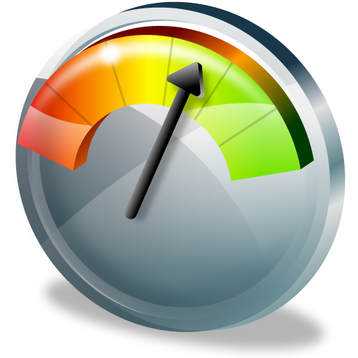
Model Performance Evaluation Classification Problems
Notes:
Guidelines
Use a title slide at the beginning of your presentation. There are 9 variations of title slides to choose from.
If you will have a series of slideshows, we recommend using the same style of title slide for each presentation.
Keep your title to no more than 2 lines.
Do not change the font style or font size of the title or subtitle.

Slide 3
Performance Metrics
These are used to measure how good a model is.
Also called evaluation metrics and depend on the task:
Regression Metrics
Classification Metrics
Propensity Metrics

Slide 4
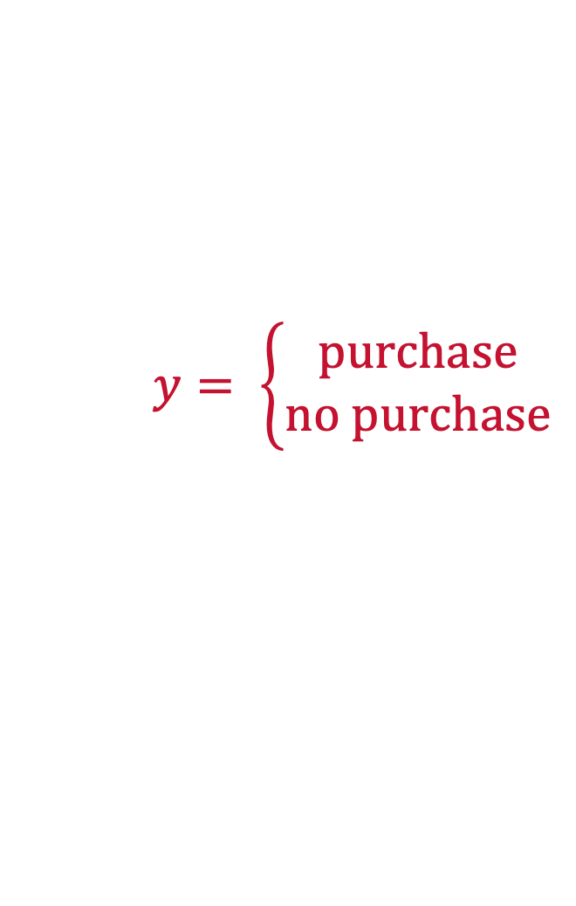
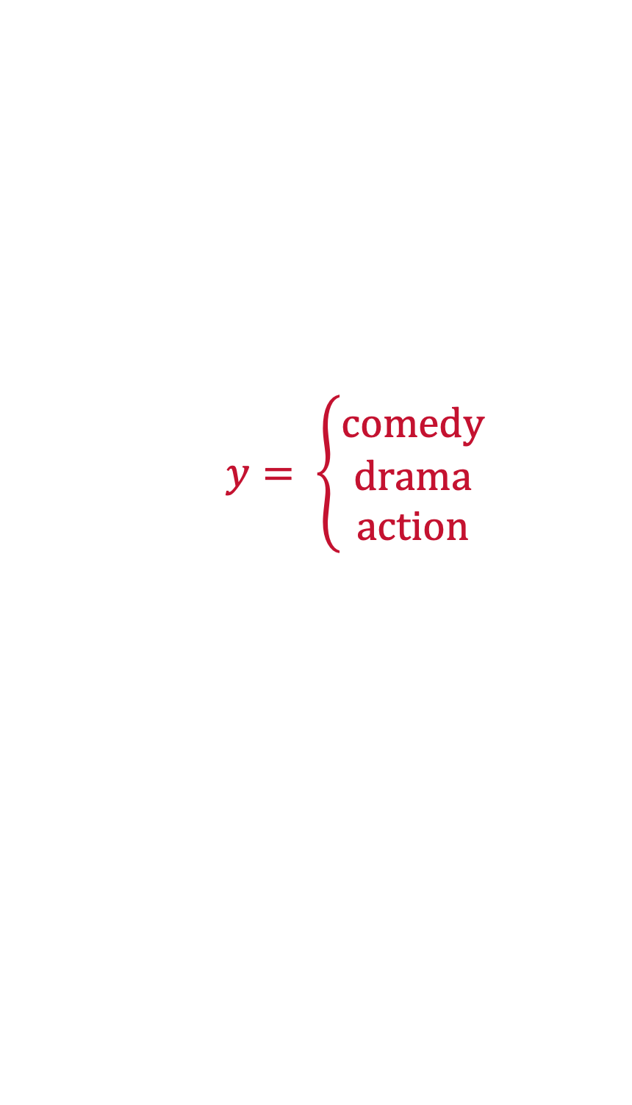

Classification
The goal of a classifier is to place an observation into a group
Problems can be binary, multi-class or multi-label
BINARY
MULTI-CLASS
MULTI-LABEL
$$y= \left\{\begin{aligned}positive \\ neutral \\ negative\end{aligned}\right.$$
$$y= \left\{\begin{aligned}comedy \\ drama \\ action\end{aligned}\right.$$
$$y= \left\{\begin{aligned}purchase \\ no purchase\end{aligned}\right.$$

Slide 5
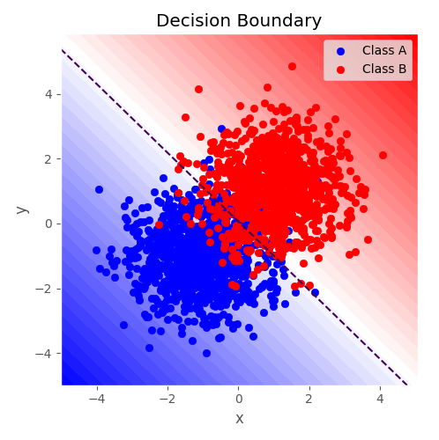

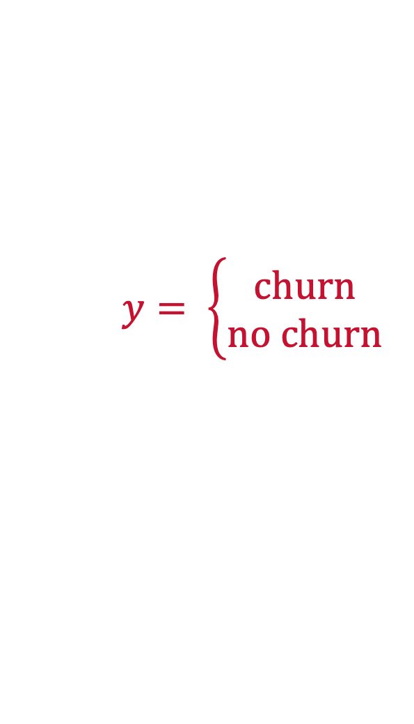

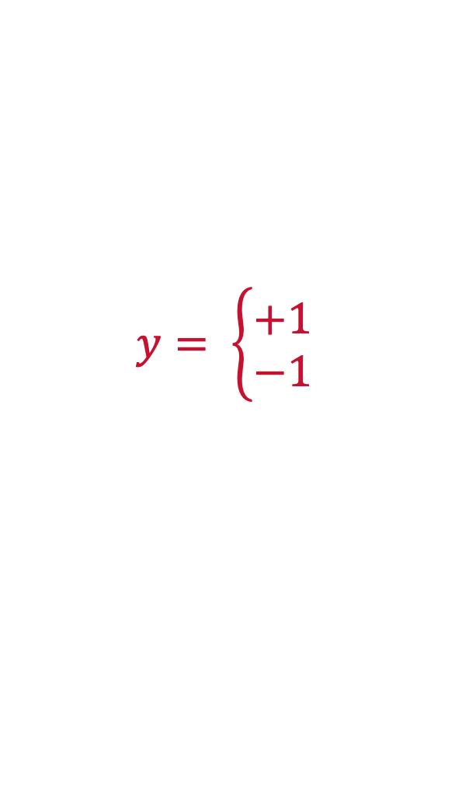
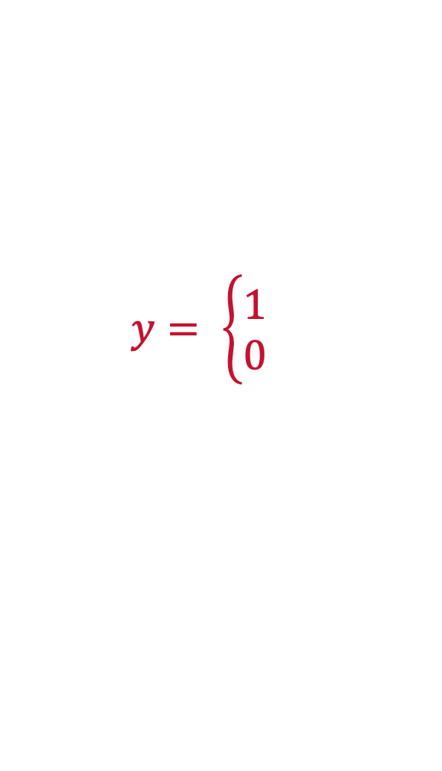
Binary Classification
Task of classifying the elements of a set into one of two groups
We use supervised learning algorithms for binary classification
$$y= \left\{\begin{aligned}purchase \\ no purchase\end{aligned}\right.$$
$$y= \left\{\begin{aligned}churn \\ no churn\end{aligned}\right.$$
$$y= \left\{\begin{aligned}default \\ no default\end{aligned}\right.$$
ENCODING
$$y= \left\{\begin{aligned}1 \\ 0\end{aligned}\right.$$
$$y= \left\{\begin{aligned}+1 \\ −1\end{aligned}\right.$$

Slide 6
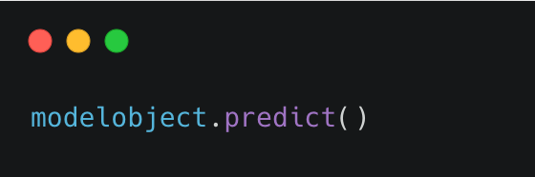
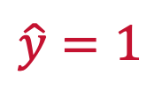

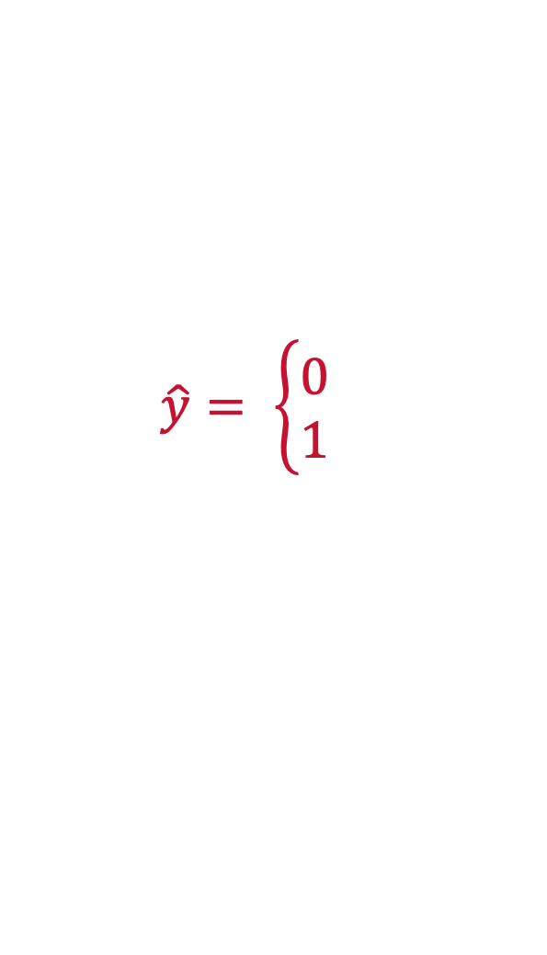
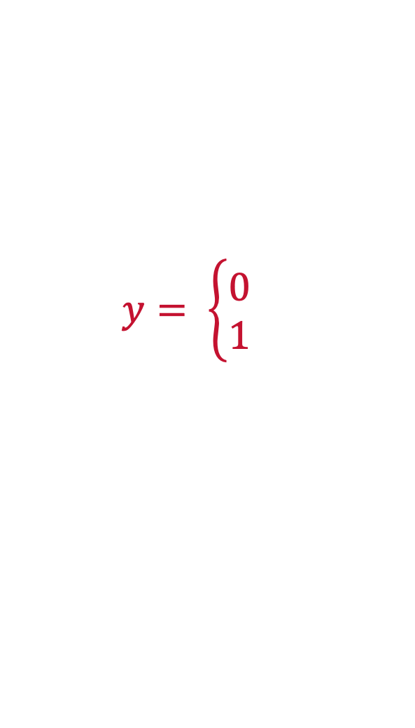
Classification Predictions
Model can return the predicted class label(s)
The predicted class labels are usually called $\hat{y}$
$$y= \left\{\begin{aligned}0 \\ 1\end{aligned}\right.$$
$$\hat{y}= \left\{\begin{aligned}0 \\ 1\end{aligned}\right.$$
$$\hat{y}=1$$

Slide 7
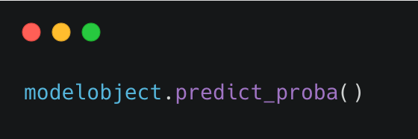
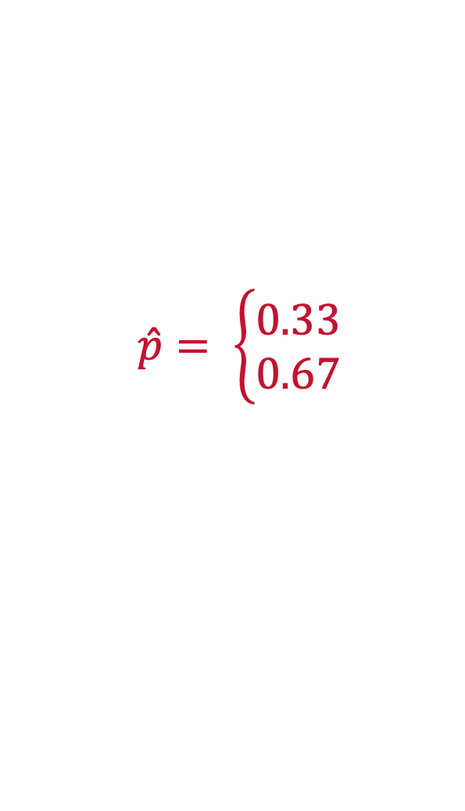

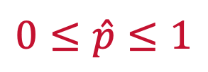
Classification Propensities
Model can also return the probability of belonging to a class
The propensity (probability) is usually called $\hat{p}$
$$y= \left\{\begin{aligned}0 \\ 1\end{aligned}\right.$$
$$0≤\hat{p}≤1$$
$$\hat{p}= \left\{\begin{aligned}0.33 \\ 0.67\end{aligned}\right.$$

Slide 8
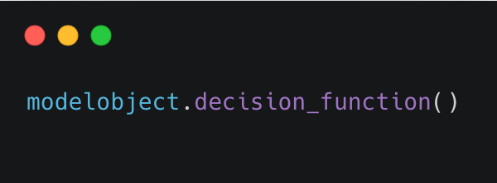


Classification Decision Function
Returns a score that can be used to determine the class label
Usually a distance metric from some threshold
$$y= \left\{\begin{aligned}0 \\ 1\end{aligned}\right.$$
$$−∞≤θ≤∞$$
$$θ=5.2$$

Slide 9
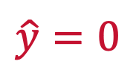
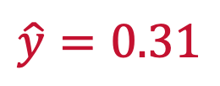
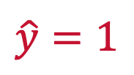
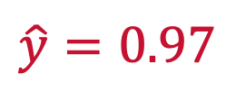
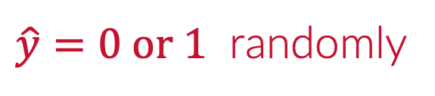
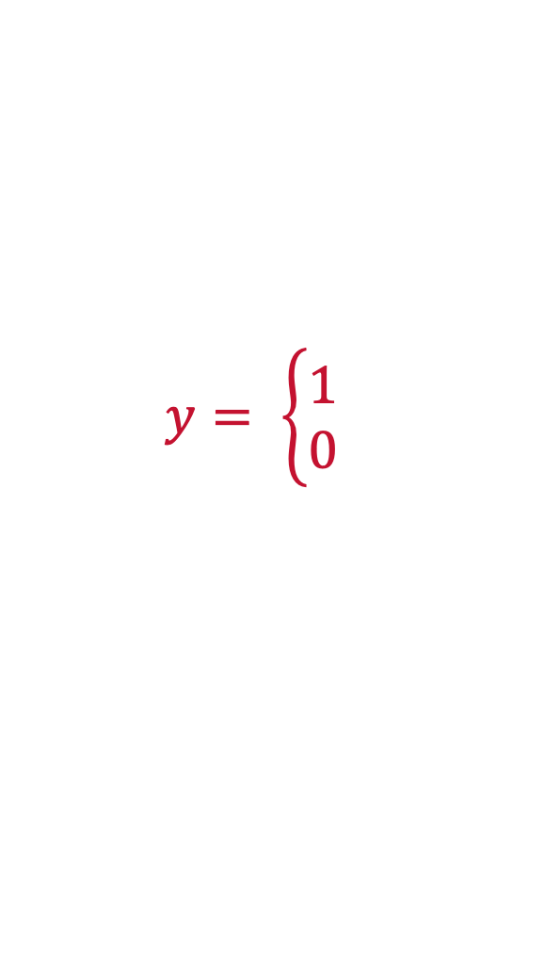
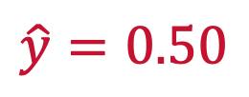
Propensity Threshold
We assign a threshold to predict the event of interest “1”
Generally, 0.5 is chosen.
The threshold can be optimized
$$y= \left\{\begin{aligned}1 \\ 0\end{aligned}\right.$$
THRESHOLD (0.5)
$$\hat{y}=0.97$$
$$\hat{y}=1$$
$$\hat{y}=0.31$$
$$\hat{y}=0$$
$$\hat{y}=0.50$$
$\hat{y}=0 or 1$ randomly

Slide 10
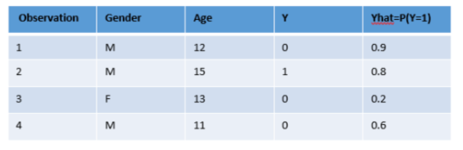
Classification Threshold
Threshold optimization can change performance

Slide 11
Benchmark for Classification
If you had no model what would the best prediction be?
The Naïve Model is to predict with the most common class

Slide 12
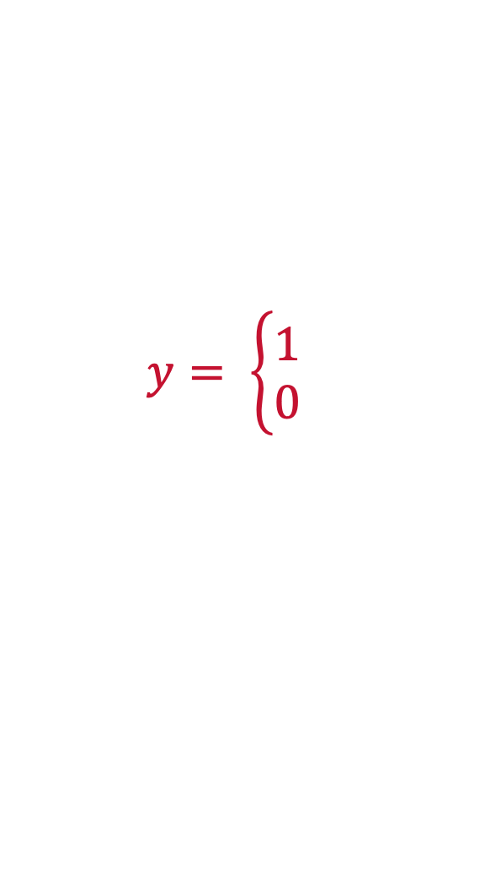
Classification Metrics
Metrics depend on type of classification: binary, multi-class/label
Must rely on an overall performance over all observations
$$y= \left\{\begin{aligned}1 \\ 0\end{aligned}\right.$$

Slide 13
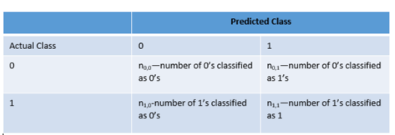
The Confusion Matrix
We can count the number of correct and incorrect classifications
The confusion matrix is a table that summarizes the performance

Slide 14
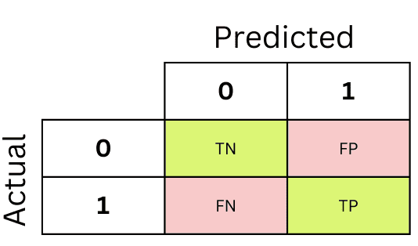
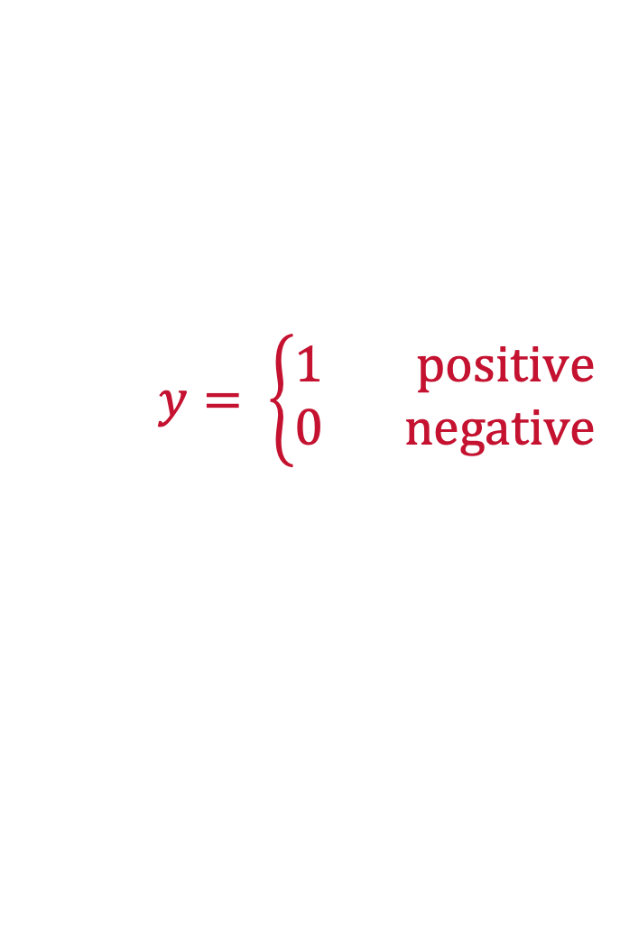
The Confusion Matrix
We can count the number of correct and incorrect classifications
True Positives, True Negatives, False Positives and False Negatives
$$y= \left\{\begin{aligned}1 positive \\ 0 negative\end{aligned}\right.$$

Slide 15
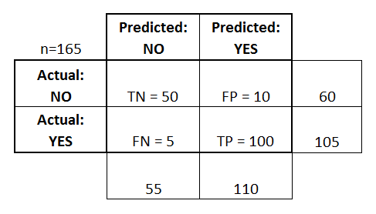




The Confusion Matrix
The confusion matrix gives a summary of overall performance
TP+TN+FP+FN = number of observations
$$n_{0,0}$$
$$n_{0,1}$$
$$n_{1,0}$$
$$n_{1,1}$$

Slide 16



Please download and install the Slido app on all computers you use
Comparing the true value vs the predicted values, what is the value of the TP?
ⓘ Start presenting to display the poll results on this slide.

Slide 17
Please download and install the Slido app on all computers you use
Comparing the true value vs the predicted values, what is the value of FN?
ⓘ Start presenting to display the poll results on this slide.

Slide 18
Please download and install the Slido app on all computers you use
Comparing the true value vs the predicted values, what is the value of the FP?
ⓘ Start presenting to display the poll results on this slide.

Slide 19
Please download and install the Slido app on all computers you use
Comparing the true value vs the predicted values, what is the value of TN?
ⓘ Start presenting to display the poll results on this slide.

Slide 21
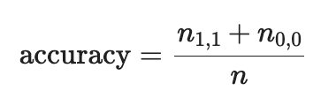
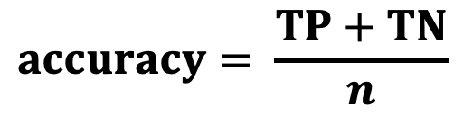
Accuracy
The accuracy metric measures number of obs predicted correctly
It is one of the most important classification metrics
$$n_{0,0}$$
$$n_{0,1}$$
$$n_{1,0}$$
$$n_{1,1}$$
$$accuracy= \frac{TP+TN}{n}$$

Slide 22

Please download and install the Slido app on all computers you use
Let's consider a business scenario where a bank wants to predict whether a customer will default on a loan. Here, y_true represents whether the customer actually defaulted (1) or not (0), and y_pred represents the bank's prediction about the customer defaulting. What is the accuracy of this model?
ⓘ Start presenting to display the poll results on this slide.

Slide 23
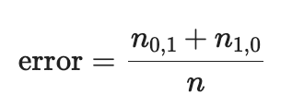
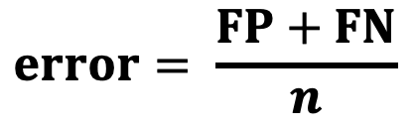
Misclassification Rate – Error
Measures number of obs predicted incorrectly
$$n_{0,0}$$
$$n_{0,1}$$
$$n_{1,0}$$
$$n_{1,1}$$
$$error= \frac{FP+FN}{n}$$

Slide 24
Please download and install the Slido app on all computers you use
Let's consider a business scenario where a bank wants to predict whether a customer will default on a loan. Here, y_true represents whether the customer actually defaulted (1) or not (0), and y_pred represents the bank's prediction about the customer defaulting. What is the error of this model?
ⓘ Start presenting to display the poll results on this slide.

Slide 25
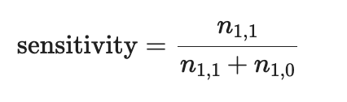
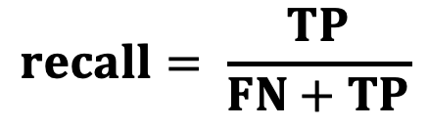
Sensitivity – Recall – Detection Rate - TPR
The fraction of all 1’s that are classified (predicted) as 1’s.
$$n_{0,0}$$
$$n_{0,1}$$
$$n_{1,0}$$
$$n_{1,1}$$
$$recall= \frac{TP}{FN+TP}$$

Slide 26
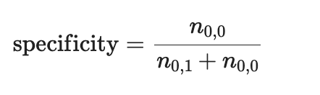
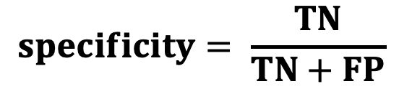
Specificity
The Fraction of all of the 0’s that are classified as 0’s.
$$n_{0,0}$$
$$n_{0,1}$$
$$n_{1,0}$$
$$n_{1,1}$$
$$specificity= \frac{TN}{TN+FP}$$

Slide 27
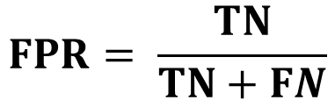




1-Specificity
The False Positive Rate (FPR)
$$n_{0,0}$$
$$n_{0,1}$$
$$FPR= \frac{TN}{TN+FN}$$
$$n_{1,0}$$
$$n_{1,1}$$

Slide 28
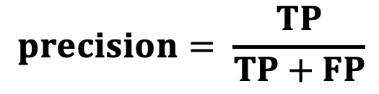
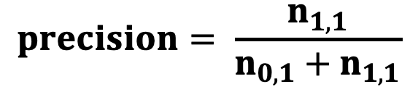
Precision
The fraction of predicted values that are correct.
$$precision= \frac{n_{1,1}}{n_{0,1}+n_{1,1}}$$
$$n_{0,0}$$
$$n_{0,1}$$
$$n_{1,0}$$
$$n_{1,1}$$
$$precision= \frac{TP}{TP+FP}$$

Slide 29
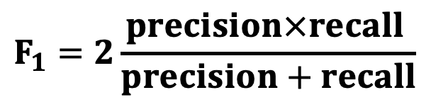
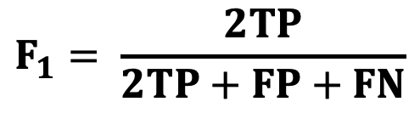
F₁ Score
Harmonic mean of recall and precision.
$$F_{1}=2\frac{precision×recall }{precision+recall}$$
$$n_{0,0}$$
$$n_{0,1}$$
$$n_{1,0}$$
$$n_{1,1}$$
$$F_{1}= \frac{2TP}{2TP+FP+FN}$$

Slide 30
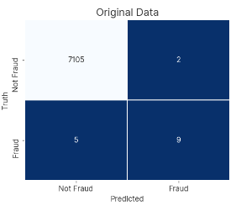
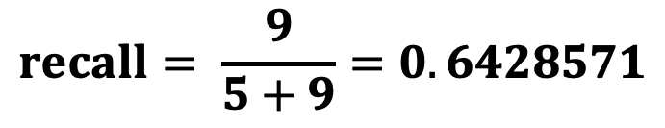
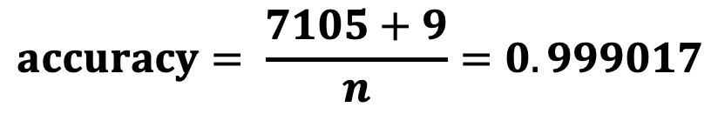
Class Imbalance
When one class significantly outweighs other(s) in data
Common in fraud detection, rare diseases
Models favor majority class
$$accuracy= \frac{7105+9}{n}=0.999017$$
$$recall= \frac{9}{5+9}=0.6428571$$

Slide 31
Python
Notes:
Guidelines
Use a title slide at the beginning of your presentation. There are 9 variations of title slides to choose from.
If you will have a series of slideshows, we recommend using the same style of title slide for each presentation.
Keep your title to no more than 2 lines.
Do not change the font style or font size of the title or subtitle.

